Slide 1
Project Report: AtliQ Hospitality Analysis
Name - Akash Shital Patil
UNID - UMIP5670

Slide 2
Project Report: Enhancing Business Performance in the Hospitality Industry
Table of Contents:
Introduction
Brief Overview of the Project
Objectives
Data Exploration
Insights from Jupyter Notebook Analysis
Overview of Datasets
Data Visualization and Analysis
Tableau Dashboard Insights
Key Visualizations and Findings
Insights and Recommendations
Extracted Insights from Data Analysis
Actionable Recommendations for Business Improvement
Conclusion
Summary of Key Findings
Project Impact and Future Steps

Slide 3
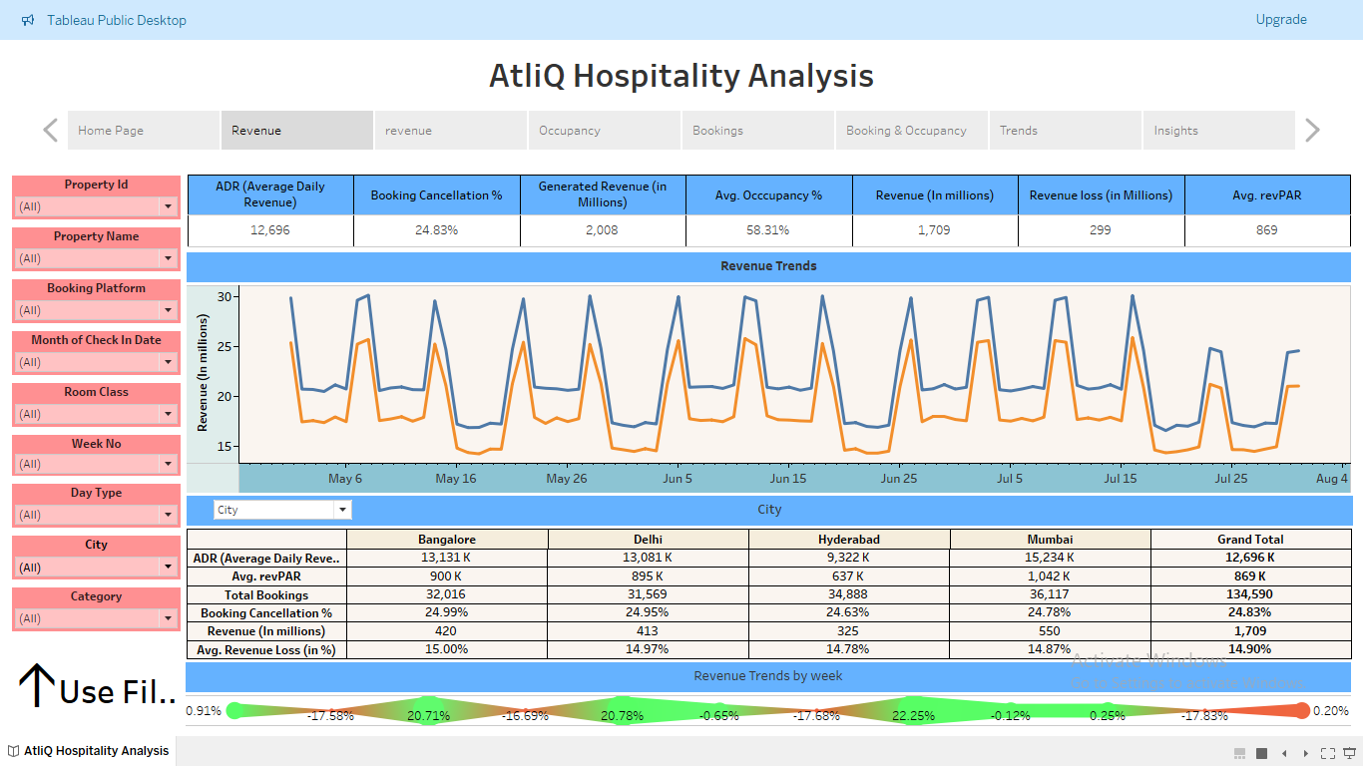
1. Introduction:
Brief Overview:
Our project focuses on leveraging data analytics and business intelligence to enhance business performance within the hospitality industry. We aim to provide actionable insights to Atliq Grands, a leading hotel chain, to regain their competitive edge and improve revenue generation.
Objectives:
Analyze provided datasets to identify key trends and patterns.
Develop visualizations and dashboards for clear data representation.
Derive actionable recommendations to improve business operations and decision-making.

Slide 4
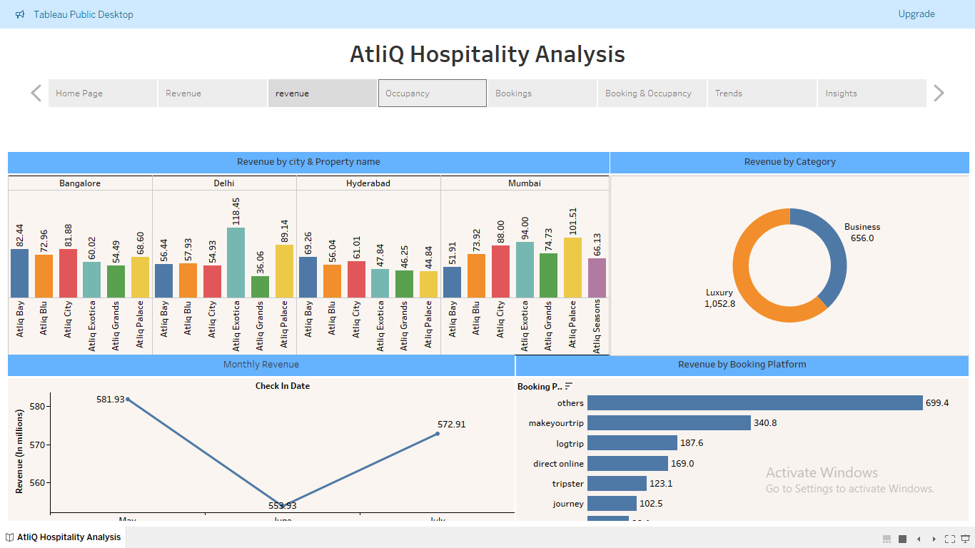
2. Data Exploration:
Insights from Jupyter Notebook Analysis:
Explored five datasets including dim_date, dim_rooms, dim_hotels, fact_aggregated_bookings, and fact_bookings.
Combined and preprocessed data for analysis, merging relevant information from multiple datasets.
Conducted exploratory data analysis to understand dataset structures and characteristics.
Identified key variables and potential areas for analysis.
Overview of Combined Datasets:
Detailed analysis of combined datasets, highlighting dimensions, key columns, and observations.
Insights obtained from each dataset, emphasizing their contribution to the overall analysis.
Preprocessing steps performed to ensure data consistency and integrity.

Slide 5
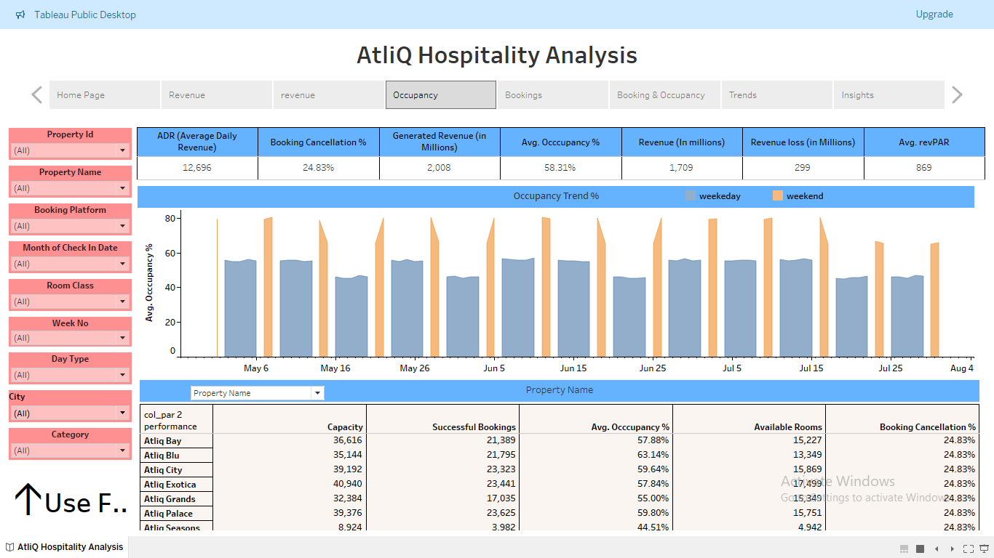
3. Data Visualization and Analysis:
Tableau Dashboard Insights:
Utilized Tableau for data visualization and analysis.
Created interactive dashboards to explore various aspects of business performance.
Extracted insights related to revenue generation, customer satisfaction, booking patterns, and property performance.
Key Visualizations and Findings:
Revenue analysis across different properties, cities, and room categories.
Occupancy trends, booking patterns, and revenue per available room.
Customer satisfaction ratings and their impact on revenue.

Slide 6
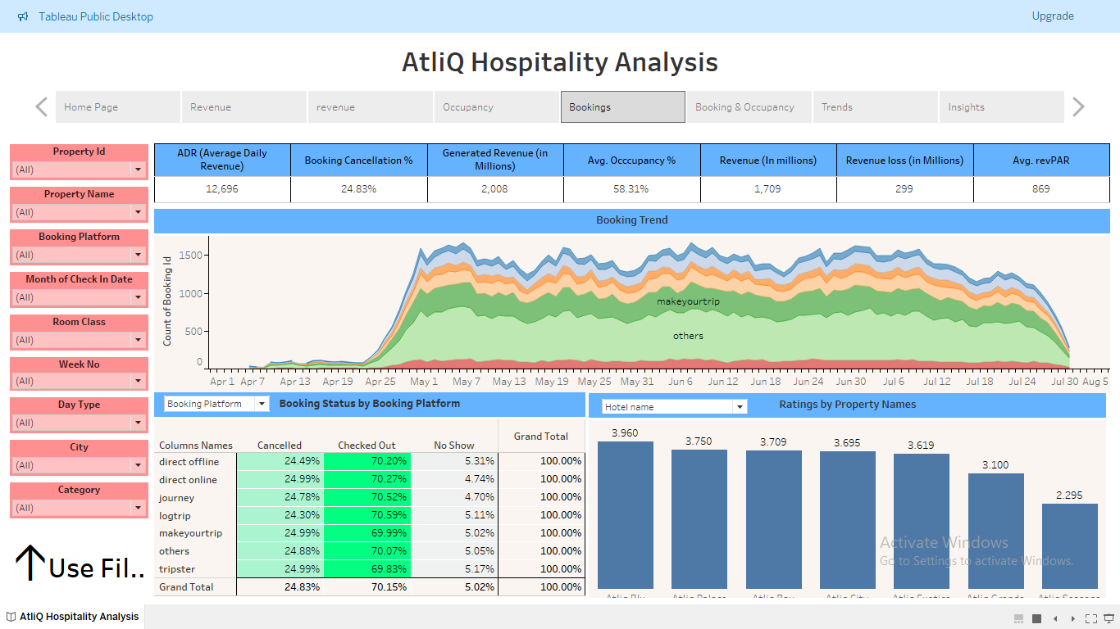
4. Insights and Recommendations:
Extracted Insights from Data Analysis:
Identified revenue trends, including revenue loss due to cancellations.
Analyzed occupancy rates, booking patterns, and revenue drivers.
Explored correlations between variables and their impact on business performance.
Actionable Recommendations for Business Improvement:
Enhance booking management with dynamic pricing and flexible cancellation policies.
Optimize revenue streams through diversified offerings and targeted marketing strategies.
Maximize property performance with upgrades and operational efficiencies.

Slide 7
5. Conclusion:
Summary of Key Findings:
Provided a comprehensive overview of insights derived from data analysis.
Highlighted key areas for business improvement and revenue optimization.
Demonstrated the value of data-driven decision-making in the hospitality industry.
Project Impact and Future Steps:
Discussed the potential impact of recommendations on business performance.
Outlined future steps for implementation and further analysis.
Concluded with the importance of ongoing data analysis and business intelligence in maintaining a competitive edge.

Slide 8
Thank You!
Akash Shital Patil
UMIP5670

